Slide 1
Learning Session 1 Overview of Process Mapping and Impact-Effort Grids

Slide 2
The presence of the Laboratory African Regional Collaboration (LARC) logo on slides
indicates that content (in whole or in part) originates with the LARC Program

Slide 3
Guiding Principles for Quality Improvement
Focus on the needs of the users
Focus on processes to increase the productivity of work
Use data to improve services
Use teams to improve quality
Improve communication

Slide 4
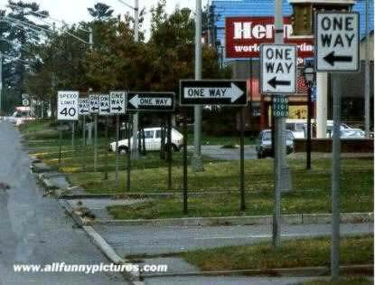
Process Mapping
“Most Problems are Found in Processes and Systems, Not in People”
How Processes Fail
Poor design
Too complex
Not well understood by those who work in them
Not set up to deliver what the “individuals and populations” require
LARC Learning Session I PowerPoint

Slide 5
Rationale for Process Mapping
Mapping and analyzing processes are useful management tools.
They provide an organized method of improving flow and evaluating issues that arise in the laboratory.
Mapping a process (all the steps from the beginning to the end of an activity) is a tool that allows analysis and optimization of workflow and service delivery.
The use of standardized procedures prevents variation in the system; thereby avoiding many pitfalls.
LARC Learning Session I PowerPoint

Slide 6
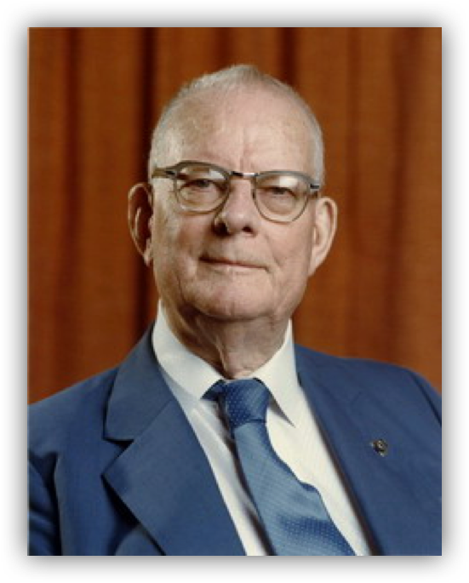
"The first step in any organization is to draw a flow diagram (process map) to show how each component depends on others. Then everyone may understand what their job is. If people do not see the process, they cannot improve it."
W Edwards Deming (1900-1993)
LARC Learning Session I PowerPoint

Slide 7
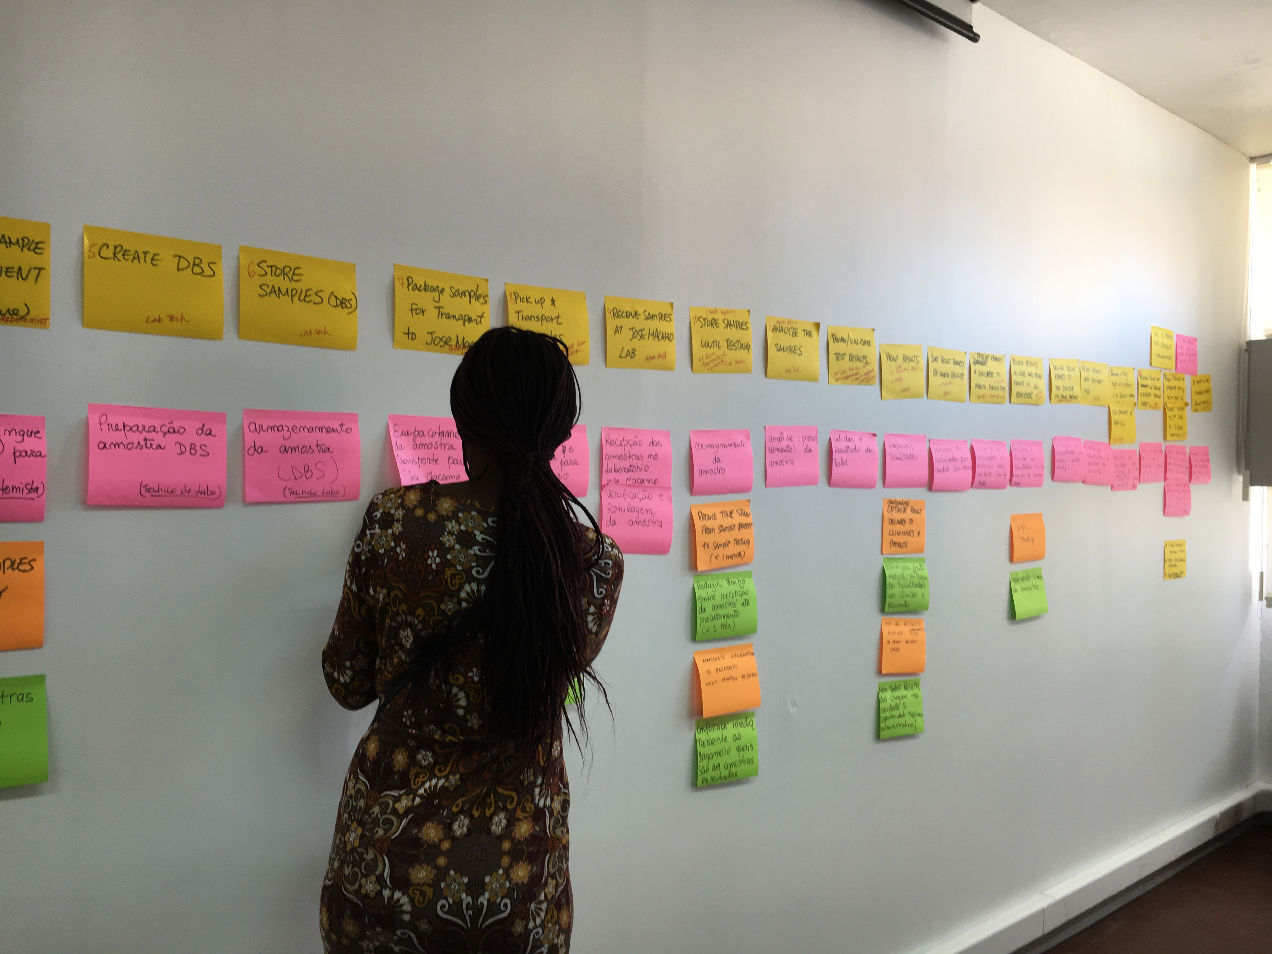
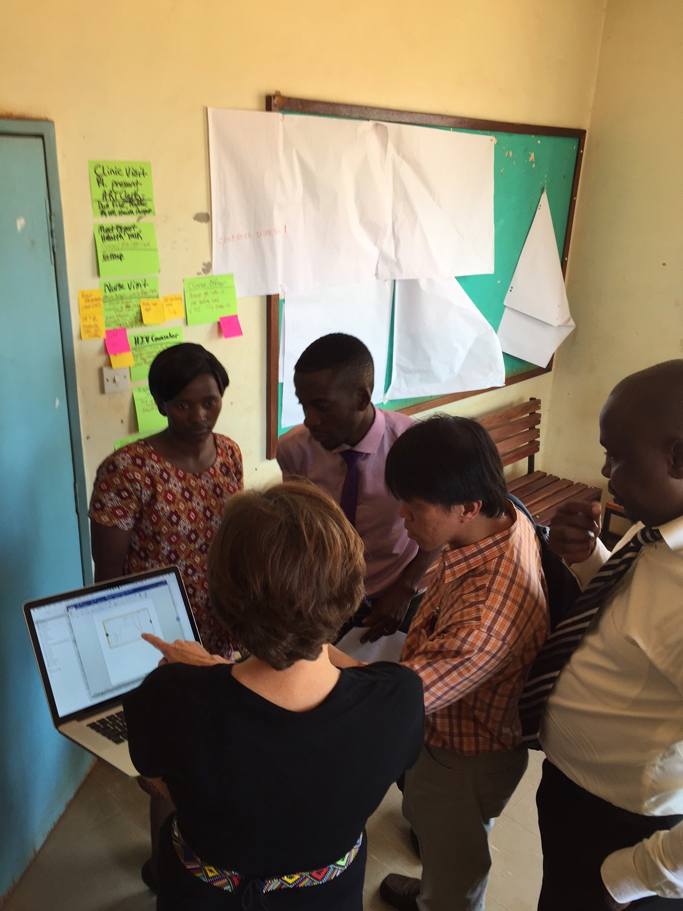
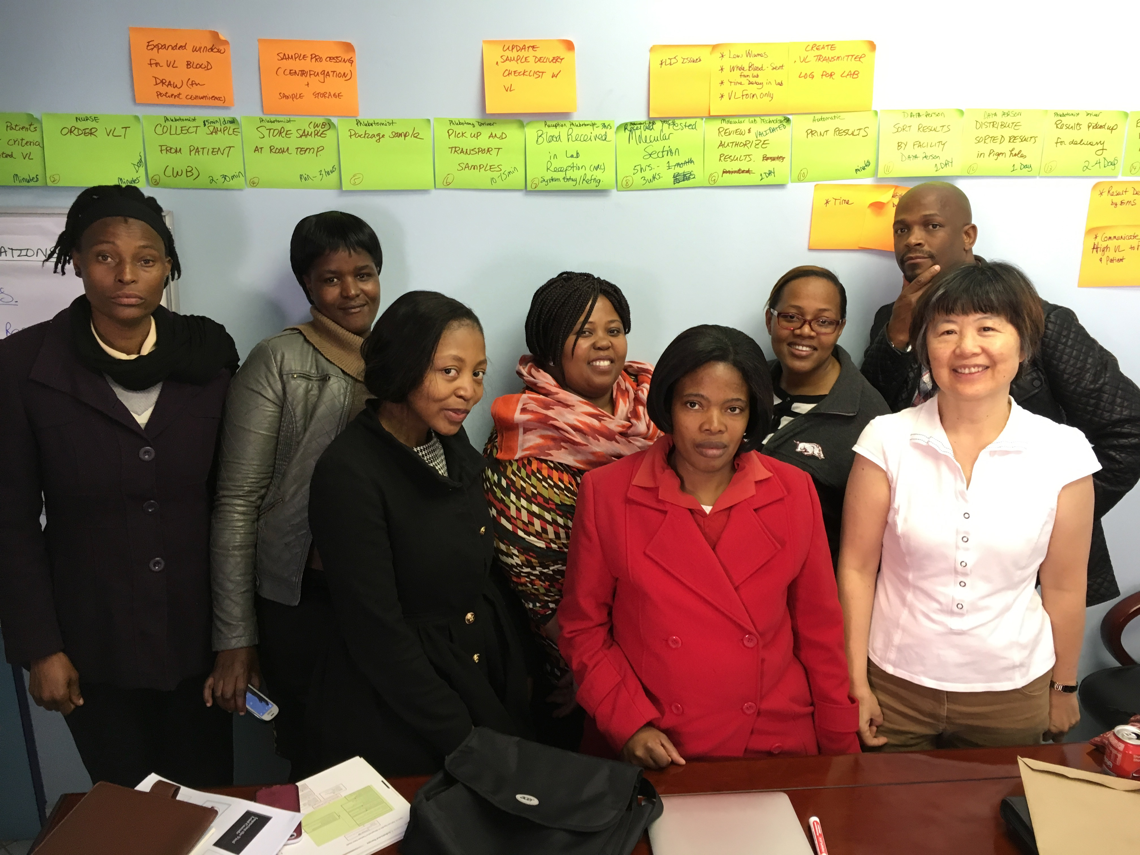
Process Mapping
LARC Learning Session I PowerPoint

Slide 8
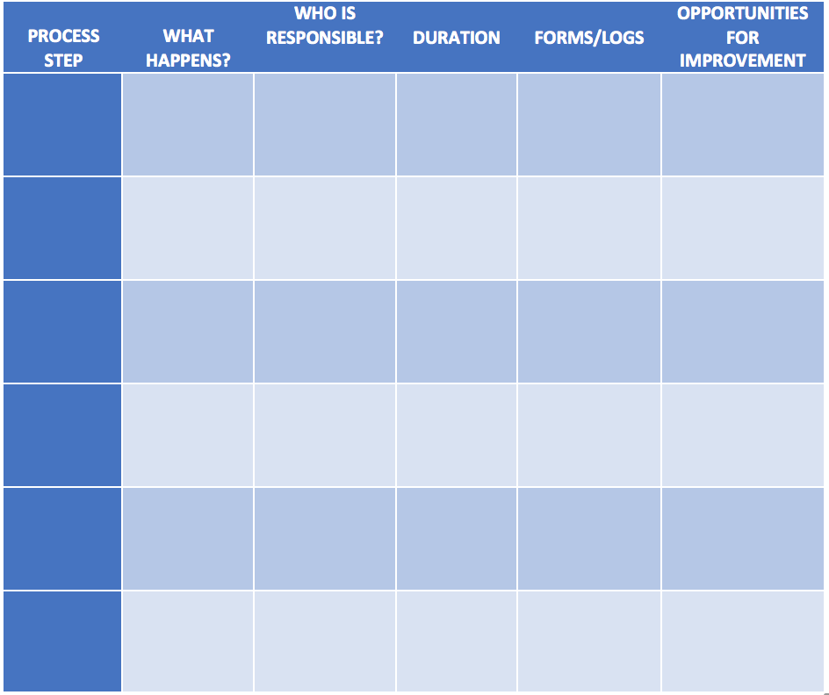
Process Mapping Guide
Pages 38-40: LARC Workbook
https://www.larccqi.org/uploads/resources/LARC-3.0-WORKBOOK.pdf
LARC Learning Session I PowerPoint

Slide 9
To Improve a Process
See
Understand
Improve
LARC Learning Session I PowerPoint
Notes:
WHY
To improve a process, you must first see and understand the process.
SEE
The process map is visual. Visual information is a more efficient way of communication.
UNDERSTAND
Help everyone to see the entire process and their place in the process
Clearly define the current process or variation in the process; Understand what is actually happening
Identify wasteful steps and inefficiencies
IMPROVE
Improving the process by eliminating the wasteful steps and/or reordering the steps for maximum efficiency
A visual picture of the future (improved) state PM can be created & communicated
The improved PM can be used as a tool to orient new staff & train according to new standard work

Slide 10
The Model for Improvement (IHI)
Aim
What are we trying to accomplish?
Measure
How will we know that a change is
an improvement?
Change
What change can we make that
will result in improvement?
Act
Plan
Small tests of change
Study
Do
LARC Learning Session I PowerPoint
Notes:
Improvement techniques are Formal methods to test changes in the steps of a process and seek to achieve greater process reliability more efficiently and at less cost
- Best to use an example like weight loss
- Reliable Process-a set of steps that when performed achieves the same result with minimum variation over time. The likelihood that a process will achieve its desired outcome is dependent on the variability of each step and the total number of steps. Reliability goes down as the number of steps increase and as the variability of the steps increases
- Test of Changes
- A test of change alters a step in a process and evaluates the impact of that alteration
- There are 3 questions to ask prior to a test of change or Plan, Do, Study Act PDSA
What are we trying to accomplish?
How will we know that a change is an improvement?
What change can we make that will result in improvements?
- PDSA’s don’t result in success or failure, they generate learning
- 4 components of PDSA
- Plan-develop an action plan to run the cycle. Predict the expected result. The who, what, where, and when. Keep it simple, only one change at a time, one shift, one day, etc.
- Do-perform the action plan
- Study-evaluate the change, and whether it performed as predicted
- Act-Reflect on what happened and use the learning to begin planning for the next test of change
- How to determine what test of changes to do
- First have a clear Aim, which means the team knows what to work towards
- Reflect on the major factors or drivers that will influence achieving the goal. This helps to focus the group’s efforts and decreases the likelihood that unnecessary work will occur
- Determining the major factors or drivers helps to limit the interventions or actions to the few that are most likely to help achieve the goal.
Plan
State the objective of the cycle, what are we trying to accomplish?
Make predictions
Generate solutions
Develop the plan to carry out the cycle (who, what, where, when)
Do
Test the change
Document problems and unexpected observations
Analysis the data
Study
Complete the analysis
Compare the data to predictions
Summarize learning's
Act
Make changes to the process
Standardize the process
Select the next cycle
What change can we make that will result in improvement?

Slide 11
Using Metrics for Improvement
Metric Selection
Data Collection Tool(s)
Data Collection Plan
Data Display
LARC Learning Session I PowerPoint

Slide 12
Metrics – WHY?
Work as Evidence-based, objective criteria for decision making
Serve as Evidence of actual improvement or gauges of project success. “How will you know if a change results in an improvement?”
Lead to Results - “What gets measured, gets fixed.”
Visually represent change
Graphs tell a story
Outcomes & goals that are not made visual will fail
LARC Learning Session I PowerPoint

Slide 13
Why Collect Data?
To establish a factual basis for making decisions
“I think the problem is…”
“The data indicates the problem is…”
vs
Opinion Driven Decisions
Data Driven Decisions
vs
LARC Learning Session I PowerPoint
Notes:
Data is needed to focus improvement efforts
Objective data is needed to make sound judgments.
Data from time studies, equipment loading data, takt times, staffing requirements, process yields, and lot and kanban sizing information will lead to workflow configurations and process layouts that help optimize value streams.
Good data collection forms organize information into useful formats, serve as communication tools, and help trigger solid improvement efforts.

Slide 14
Ask 3 Questions: The Model for Improvement
AIM
What are you trying to accomplish?
METRIC
How will you know if a change is an improvement?
CHANGE
What change will you make that will result in an improvement?
LARC Learning Session I PowerPoint

Slide 15
Metrics – When?
Define / Measure
Problem Statement – the magnitude of the problem
Aim Statement – the project goals & outcomes
Analyze
Improve
Question #2 – How will you know if a change is an improvement?
Question #3 - Which change will you make that will result in an improvement?
Control
Monitoring over time
Assuring long-term sustainability
LARC Learning Session I PowerPoint

Slide 16
Metric Selection
“Measure what matters”
LARC Learning Session I PowerPoint
Notes:
Data to align with strategic goals
Data that is available and valid
Data with an available benchmark / comparison data

Slide 17
What are some things that you can measure?
Time (e.g., length of stay, turnaround time, wait time)
Defects (e.g., Errors)
Counts (e.g., numbers of patients)
Scores (e.g., Satisfaction)
Efficiency
Productivity
Safety
Compliance
Cost
Value
Throughput/ Flow
Access
LARC Learning Session I PowerPoint

Slide 18
Key Elements of a Metric
NUMERATOR
DENOMINATOR
LARC Learning Session I PowerPoint

Slide 19
Impact / Effort Grid: A Tool for Prioritizing Opportunities
A tool to rank order potential solutions according to degree of impact and amount of effort
WHY
Allows input from the team, especially those who know the process first-hand, on the potential solutions
Provides an organized process to elicit thoughtful discussion and consensus on the potential impact of a solution and the degree of effort required to create that impact
Allows prioritization of potential solutions
LARC Learning Session I PowerPoint

Slide 20
Impact / Effort Grid
WHEN
Prioritizing solutions/opportunities
As additional solutions are generated following analysis of causes
HOW
For each group, ask:
“What would be the impact of this solution on the problem? HIGH (Major Improvement) or LOW (Minor Improvement)”
Hold the self-stick note over the accompanying half of the grid
Then ask, “How much effort would it require to accomplish this solution? EASY to do or HARD/Difficult to do)”
LARC Learning Session I PowerPoint

Slide 21
Impact / Effort Grid
HOW
Place notes in the appropriate quadrant of the grid
See grid diagram template for prioritization
Just Do It - Create short-term (1 week to 1 month) action plans for this quadrant
Just Do 2nd, if impactful – Create short to medium-term (1 week to 3 months) action plans if the team deems the solution impactful
Do 3rd, detailed planning and work – This is the quadrant from which projects (3 to 9 months) will be selected; Prioritize the first project that the team wishes to address
Maybe someday – Create list for potential long-term (9 months to a year or more) activities, place in Parking Lot, or discard
LARC Learning Session I PowerPoint

Slide 22
Impact / Effort Grid
IMPACT
EFFORT
LARC Learning Session I PowerPoint

Slide 23
Impact / Effort Grid
Projects: Detailed planning and work
Major
Improvement
Just Do It
IMPACT
Just Do It if Impactful
Maybe some day
Minor
Improvement
Easy to Do
Difficult to Do
EFFORT
LARC Learning Session I PowerPoint

Slide 24
Questions?

